Slide 1
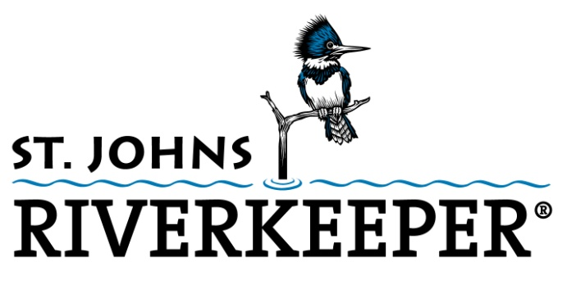
Wetlands Protection
Critical to Northeast Florida Resiliency

Slide 2
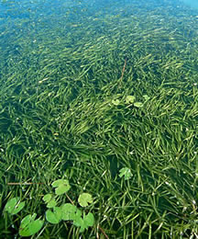
Wetlands – No Net Loss Policy
Must first try to avoid wetlands
If wetlands cannot be avoided, try to minimize impacts
If wetland impacts cannot be avoided or minimized, then permit-seekers must compensate for the losses
Photo courtesy of SJRWMD
Notes:
The photo on the left is of SAV (Submerged Aquatic Vegetation) or tapegrass, and the photo on the right is of wetlands at the Freedom Commerce Center site on the Southside. These wetlands form the headwaters of both Julington Creek and Pottsburg Creek and were slated for development until St. Johns Riverkeeper and other conservation groups were able to save them.
The photo in the middle is an aerial view of the River Town development in St. Johns County. This is an example of a development that could potentially impact both wetlands and SAV. River Town is located adjacent to Hallows Cove, a productive fish nursery and healthy stand of SAV.

Slide 3
Wetlands Perform Crucial Ecosystem Functions
Provide Critical Habitat
Filter Out Nutrients and Pollutants
Provide Shoreline Stabilization
Minimize Local Flooding
Reduce Property Loss
Photo courtesy of SJRWMD
Notes:
The photo on the left is of SAV (Submerged Aquatic Vegetation) or tapegrass, and the photo on the right is of wetlands at the Freedom Commerce Center site on the Southside. These wetlands form the headwaters of both Julington Creek and Pottsburg Creek and were slated for development until St. Johns Riverkeeper and other conservation groups were able to save them.
The photo in the middle is an aerial view of the River Town development in St. Johns County. This is an example of a development that could potentially impact both wetlands and SAV. River Town is located adjacent to Hallows Cove, a productive fish nursery and healthy stand of SAV.

Slide 4
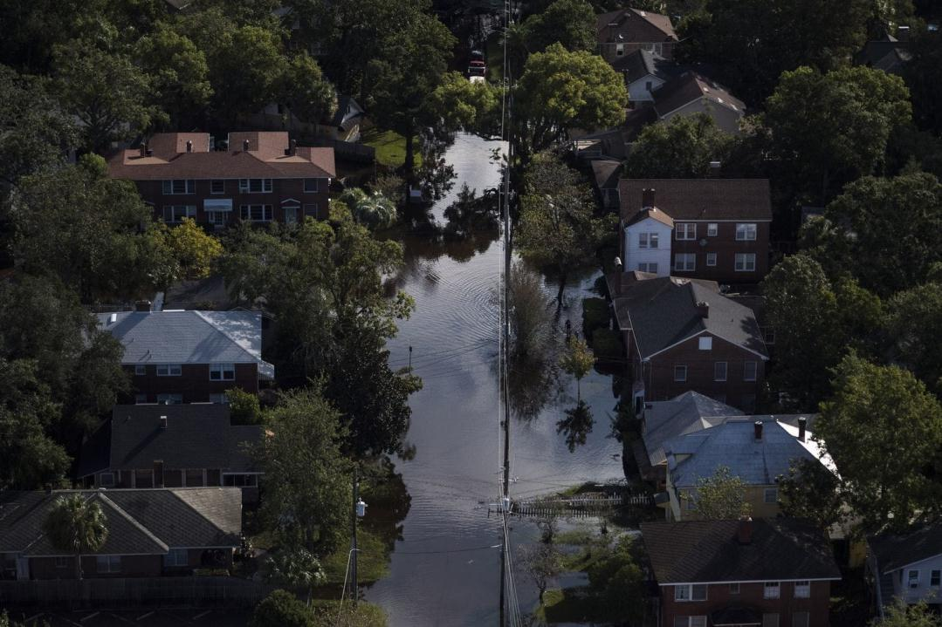
Notes:
“Driven by tidal flow, an already saturated inland waterway system and Irma's powerful winds
and rains, the swollen and
fast-rushing St. Johns River crashed over sea walls…”
The Washington Post

Slide 5
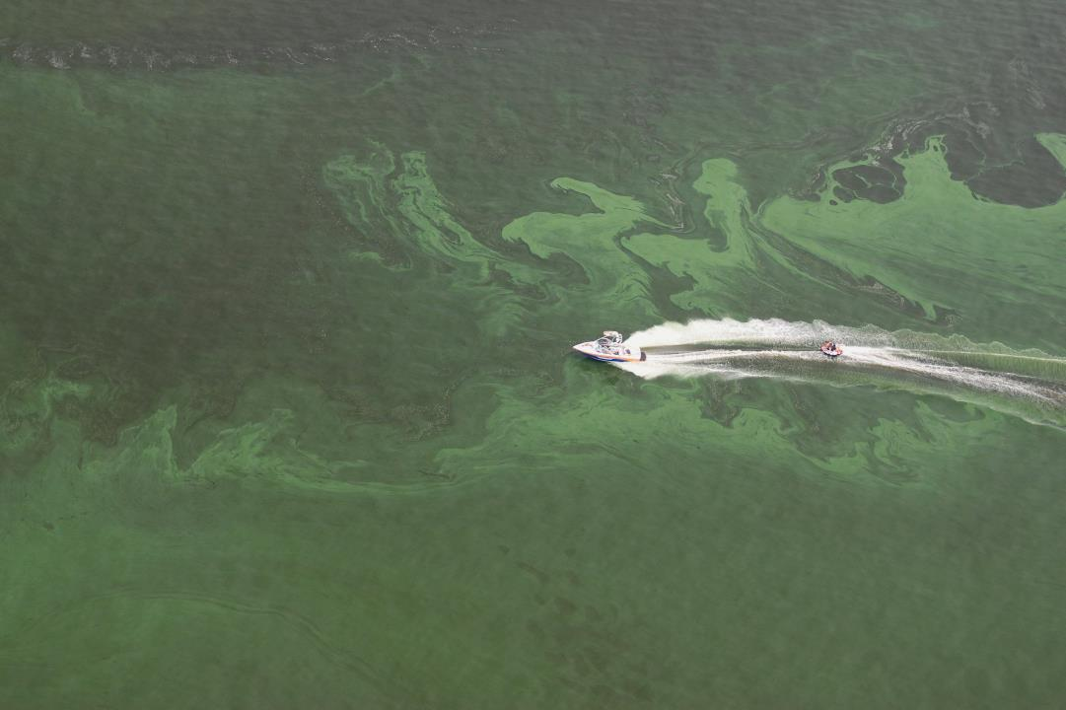

Slide 6
Estimated Nutrient Removal by St. Johns River Wetlands is Valued at More Than:
$400 million per year for Nitrogen
$500 million per year for Phosphorus
Photo courtesy of SJRWMD
Notes:
The photo on the left is of SAV (Submerged Aquatic Vegetation) or tapegrass, and the photo on the right is of wetlands at the Freedom Commerce Center site on the Southside. These wetlands form the headwaters of both Julington Creek and Pottsburg Creek and were slated for development until St. Johns Riverkeeper and other conservation groups were able to save them.
The photo in the middle is an aerial view of the River Town development in St. Johns County. This is an example of a development that could potentially impact both wetlands and SAV. River Town is located adjacent to Hallows Cove, a productive fish nursery and healthy stand of SAV.

Slide 7

Current Status is UNSATISFACTORY
Historical decrease in wetlands has been documented statewide
Development pressures and saltwater intrusion continue
Wetland Loss and Function
Photo courtesy of SJRWMD
Notes:
The photo on the left is of SAV (Submerged Aquatic Vegetation) or tapegrass, and the photo on the right is of wetlands at the Freedom Commerce Center site on the Southside. These wetlands form the headwaters of both Julington Creek and Pottsburg Creek and were slated for development until St. Johns Riverkeeper and other conservation groups were able to save them.
The photo in the middle is an aerial view of the River Town development in St. Johns County. This is an example of a development that could potentially impact both wetlands and SAV. River Town is located adjacent to Hallows Cove, a productive fish nursery and healthy stand of SAV.

Slide 8
St. Johns River Water Management District
Environmental Resource Permit (ERP)
Designed to protect water quantity, water quality and wetland functions
Mitigation required to offset adverse impacts to wetland or other surface water functions.
Wetlands Negatively Impacted through SJRWMD process is Increasing Each Year
Over-Reliance on Mitigation Banking
Photo courtesy of SJRWMD
Notes:
The photo on the left is of SAV (Submerged Aquatic Vegetation) or tapegrass, and the photo on the right is of wetlands at the Freedom Commerce Center site on the Southside. These wetlands form the headwaters of both Julington Creek and Pottsburg Creek and were slated for development until St. Johns Riverkeeper and other conservation groups were able to save them.
The photo in the middle is an aerial view of the River Town development in St. Johns County. This is an example of a development that could potentially impact both wetlands and SAV. River Town is located adjacent to Hallows Cove, a productive fish nursery and healthy stand of SAV.

Slide 9
US Army Corps of Engineers
Section 404 Permits – Clean Water Act
Protect Florida’s wetlands in large-scale landscape conversion projects such as new cities, mining, and industrial scale projects
Adverse Impacts are Offset by Mitigation
Over-Reliance on Mitigation Banks
Florida is Seeking Delegation
Photo courtesy of SJRWMD
Notes:
The photo on the left is of SAV (Submerged Aquatic Vegetation) or tapegrass, and the photo on the right is of wetlands at the Freedom Commerce Center site on the Southside. These wetlands form the headwaters of both Julington Creek and Pottsburg Creek and were slated for development until St. Johns Riverkeeper and other conservation groups were able to save them.
The photo in the middle is an aerial view of the River Town development in St. Johns County. This is an example of a development that could potentially impact both wetlands and SAV. River Town is located adjacent to Hallows Cove, a productive fish nursery and healthy stand of SAV.

Slide 10
Current Trend is WORSENING
Mitigation Banks
VS
Preservation
Creation
Enhancement
Restoration
Photo courtesy of SJRWMD
Notes:
The photo on the left is of SAV (Submerged Aquatic Vegetation) or tapegrass, and the photo on the right is of wetlands at the Freedom Commerce Center site on the Southside. These wetlands form the headwaters of both Julington Creek and Pottsburg Creek and were slated for development until St. Johns Riverkeeper and other conservation groups were able to save them.
The photo in the middle is an aerial view of the River Town development in St. Johns County. This is an example of a development that could potentially impact both wetlands and SAV. River Town is located adjacent to Hallows Cove, a productive fish nursery and healthy stand of SAV.

Slide 11
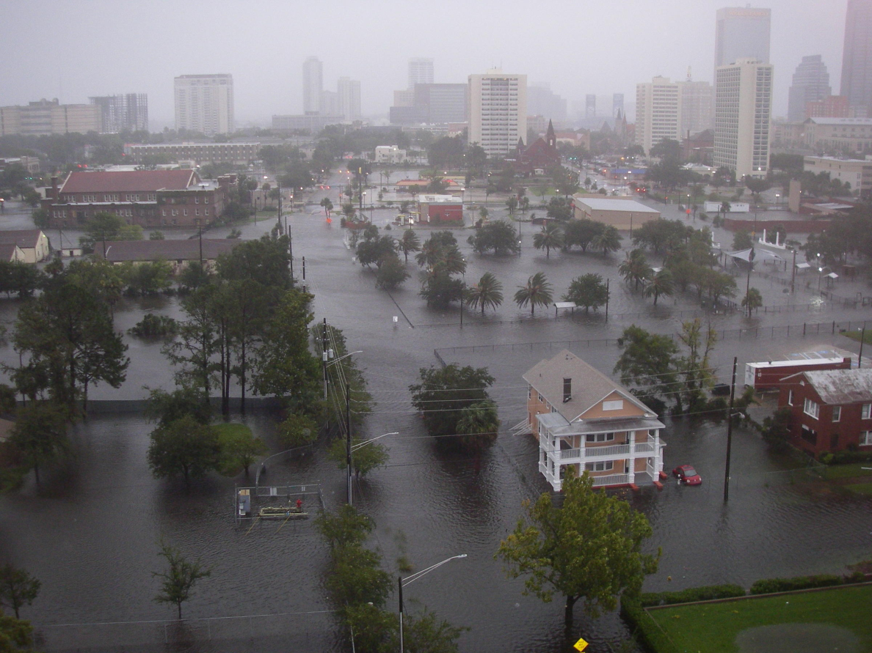
Value of Wetlands Lost –
Moved from Urban to Rural Areas
Wetland Mitigation Banks are mostly in Rural Areas
Urban Areas Lose:
  Bank Stabilization
  Water Filtration
  Flood Mitigation
  Storm Surge Protection
  Wildlife Habitat

Slide 12
Future Outlook = HIGH VULNERABILITY
Growing Population & Urbanization
Increased Development along Waterways
Saltwater Intrusion
  Water Withdrawals
  Deep Dredge
  Sea Level Rise
Rising Water Levels
  .4 ft since 1970s
  .2 ft – Deep Dredge
Photo courtesy of SJRWMD
Notes:
The photo on the left is of SAV (Submerged Aquatic Vegetation) or tapegrass, and the photo on the right is of wetlands at the Freedom Commerce Center site on the Southside. These wetlands form the headwaters of both Julington Creek and Pottsburg Creek and were slated for development until St. Johns Riverkeeper and other conservation groups were able to save them.
The photo in the middle is an aerial view of the River Town development in St. Johns County. This is an example of a development that could potentially impact both wetlands and SAV. River Town is located adjacent to Hallows Cove, a productive fish nursery and healthy stand of SAV.

Slide 13
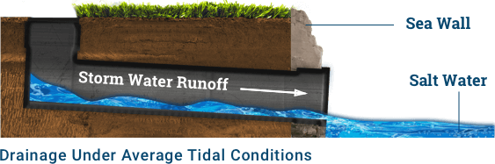
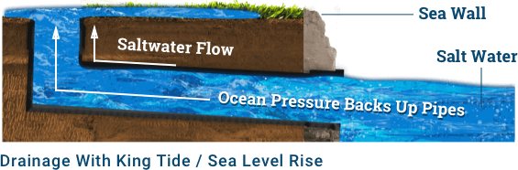

Slide 14
Resilience
The ability to anticipate, to prepare for,
and adapt to changing conditions
and withstand, respond to,
and recover rapidly from disruptions.

Slide 15
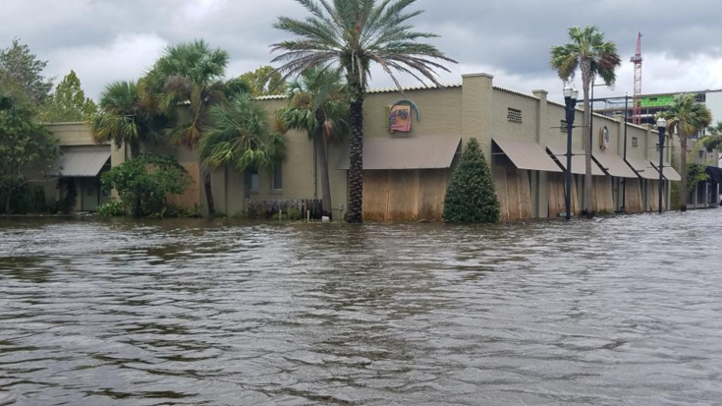
Comprehensive Vulnerability Assessment

Slide 16
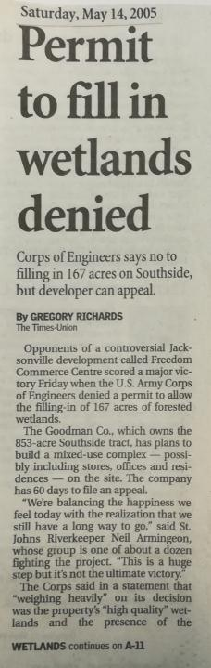
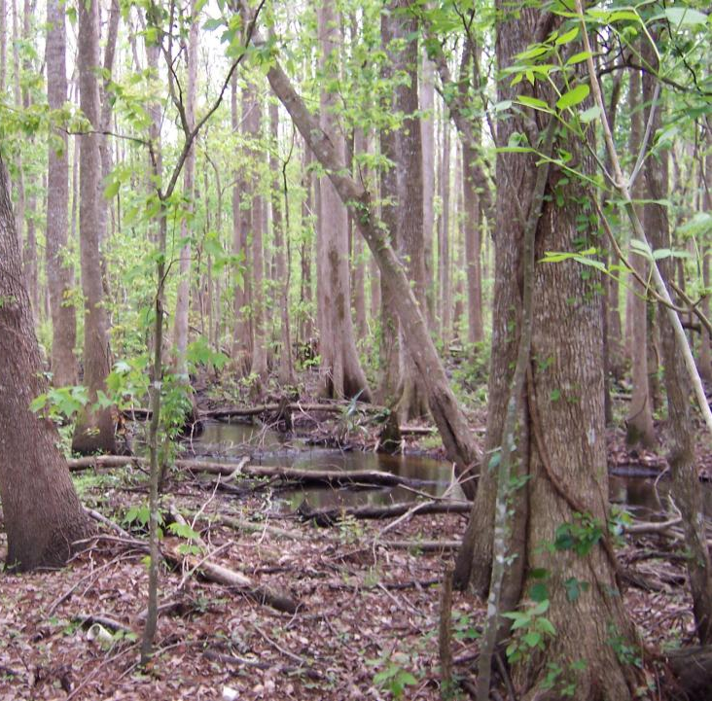

Slide 17
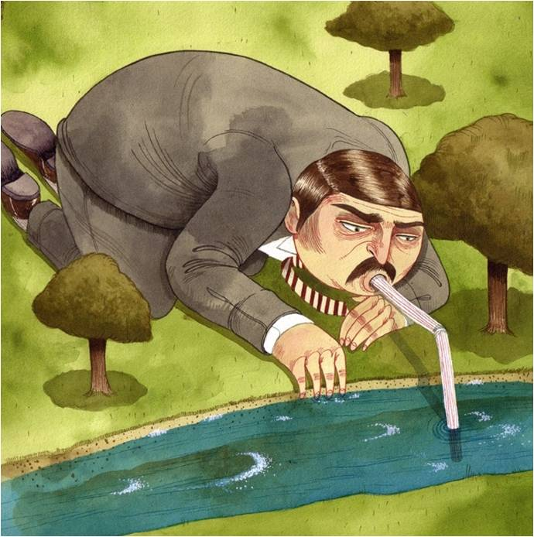
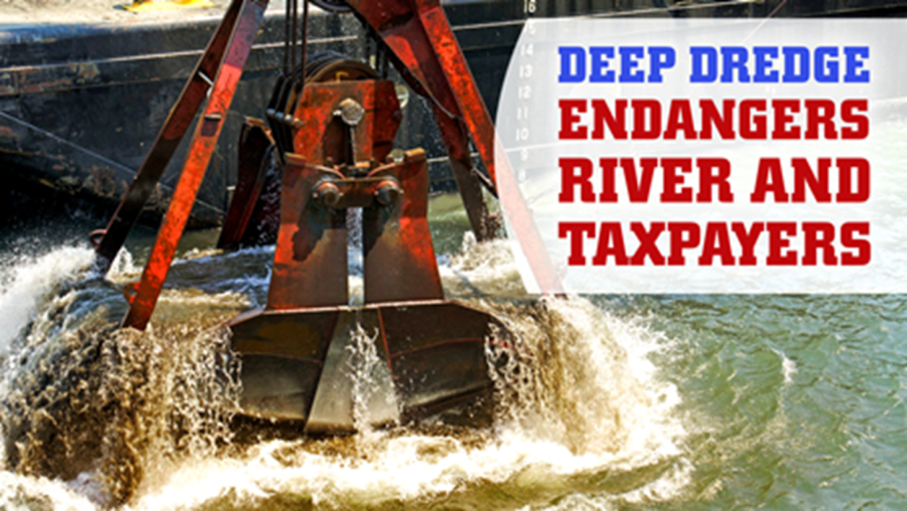
Fully Mitigate Damaging Permits

Slide 18
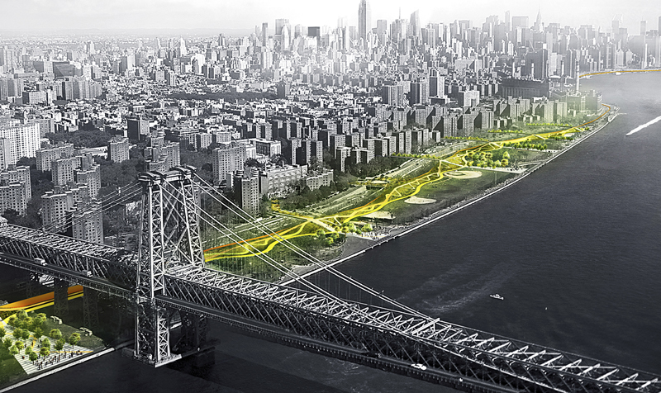
The Eastside Coastal Resiliency Project
Develops Wetlands
Reduces Flood Risk
Creates Public Spaces
Enhances Water Quality
Notes:
The East Side Coastal Resiliency (ESCR) Project is an integrated coastal protection system that will reduce the risk of flooding and facilitate access to the waterfront, creating improved public spaces and enhanced natural areas. Stretching from Montgomery Street to East 25th Street, the ESCR Project will strengthen 2.2 miles of urban coastline against floods and rising sea levels, while providing social and environmental benefits to the community the other ninety-nine percent of the time.

Slide 19
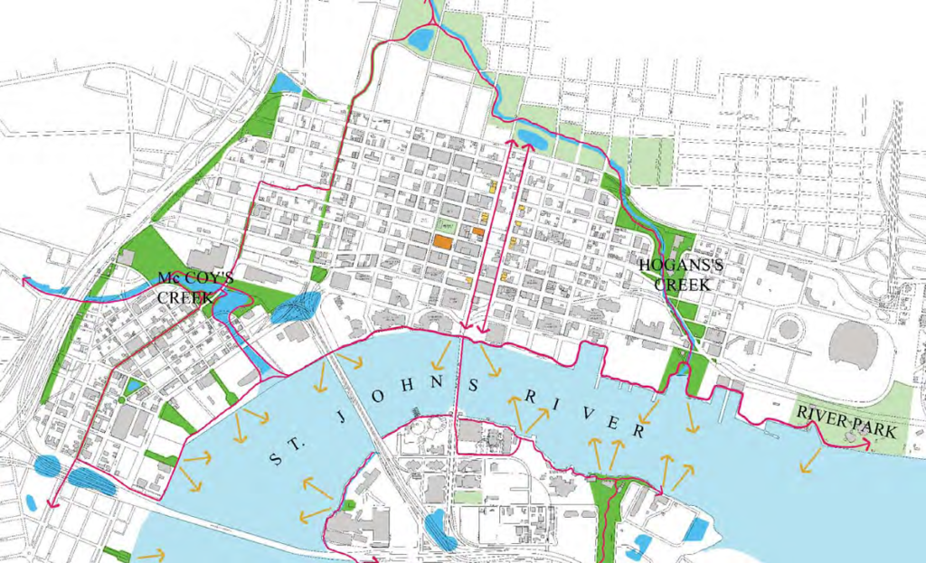
The Emerald Necklace Resiliency Project
Restores & Develops Wetlands
Reduces Flood Risk
Creates Public Spaces
Enhances Water Quality

Slide 20
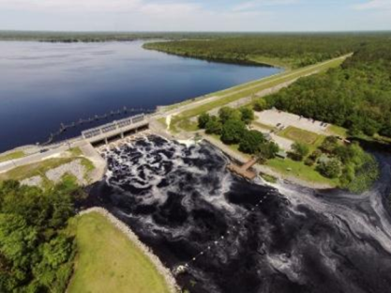
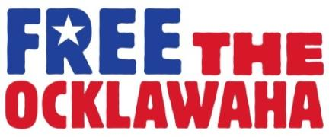
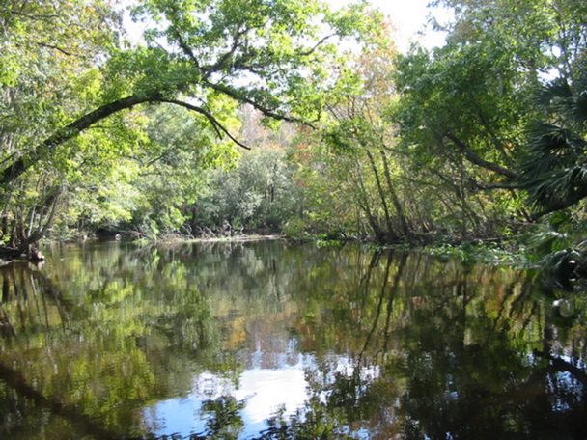
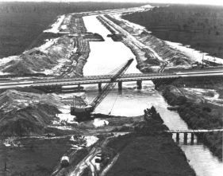

Slide 21
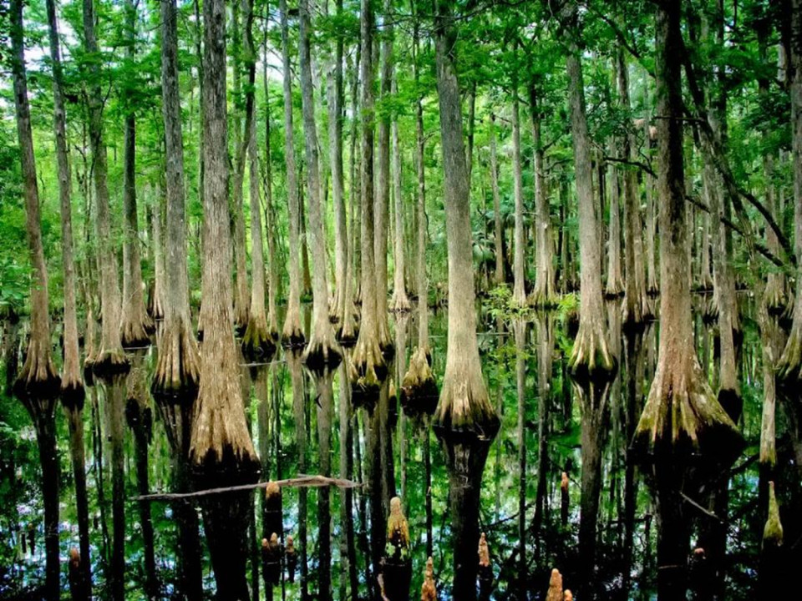
Wetlands Protections = NE Florida Resiliency

